Slide 1

The wave-particle dualism
Giuseppe Prisco (1895709) – Topics in Physics

Slide 2
Index
Introduction
Double-slit experiment with waves
Experimental problems
Photoelectric Effect
Black Body Radiation
Compton Effect
De Broglie Hypothesis
Experimental evidence for De Broglie waves
Electron diffraction experiment
Davisson and Germer experiment
Double-slit experiment with particles
Uncertainty relationships for classical waves
Heisenberg uncertainty relationships

Slide 3
Introduction
In classical physics, the waves and particles’ behavior are described by different laws and properties.
One of the properties that characterizes waves is the principle of superposition.
This principle states that in any point in which two or more different waves meet, the net amplitude at that point will be the sum of the amplitudes produced by the individual waves separately.
Moreover, when leaving the point of collision each wave will not present any distortion of its initial properties.
This property leads to the phenomenon of waves’ interference and diffraction.

Slide 4
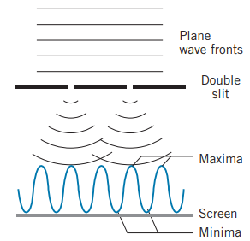

Double-slit experiment with waves (1)
In the experiment performed by Thomas Young in 1801 , a light wave illuminates a plate pierced with two parallel slits and the light passing through the slits is observed on a screen placed behind the plate.
The light wave is diffracted by the two slits and the resulting light will overlap on the screen, producing the interference.
When any wave crest from one slit arrives simultaneously with another from the other slit, we have a constructive interference.
When a crest of the wave from one slit arrives at a point on the screen simultaneously with the valley of the wave from the other slit, the two waves cancel out and we have a destructive interference.

Slide 5
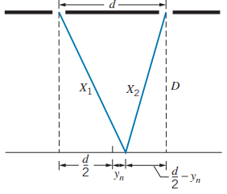
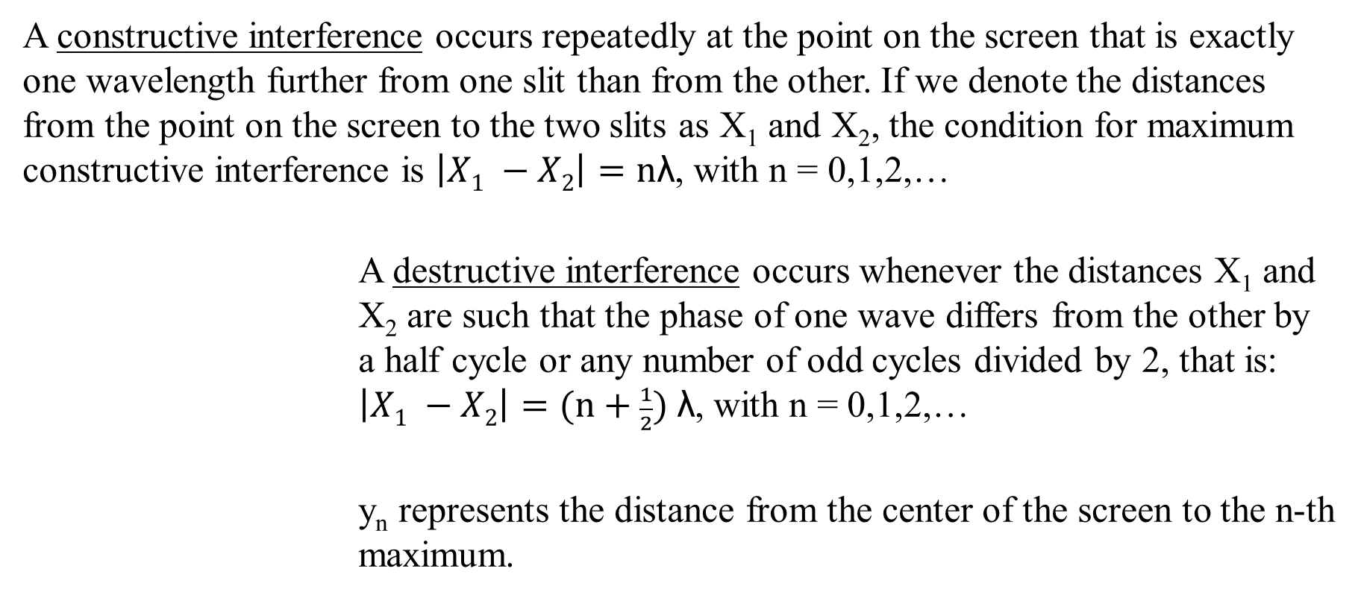
Double-slit experiment with waves (2)
A constructive interference occurs repeatedly at the point on the screen that is exactly one wavelength further from one slit than from the other. If we denote the distances from the point on the screen to the two slits as X₁ and X₂, the condition for maximum constructive interference is $\left|X1 −X2\right|=\text{n}\text{λ}$, with n = 0,1,2,…
A destructive interference occurs whenever the distances X₁ and X₂ are such that the phase of one wave differs from the other by a half cycle or any number of odd cycles divided by 2, that is: $\left|X1 −X2\right|=\text{(}\text{n}\text{ + }\frac{1}{2}) \text{λ}$, with n = 0,1,2,…
y_{n} represents the distance from the center of the screen to the n-th maximum.

Slide 6
Experimental problems
Other experiments performed in the years following the Young’s experiment showed contradictions with the wave theory of light and could not be directly explained by that theory.
These experiments include:
Photoelectric Effect
Black Body Radiation
Compton Effect

Slide 7
Photoelectric Effect (1)
In 1887, Heinrich Hertz discovered that when an electromagnetic radiation hits a metal surface, electrons are emitted, and they are called photoelectrons.
In contrast to what the classical physics predicted, the following properties were proved by experimental results:
given a fixed value for the frequency or the wavelength of the light source, the maximum kinetic energy of the emitted photoelectrons is independent of the intensity of the source
if the frequency of the light source is below a certain threshold, the photoelectric effect does not occur
when the light source is turned on, the photoelectric effect occurs almost instantaneously

Slide 8
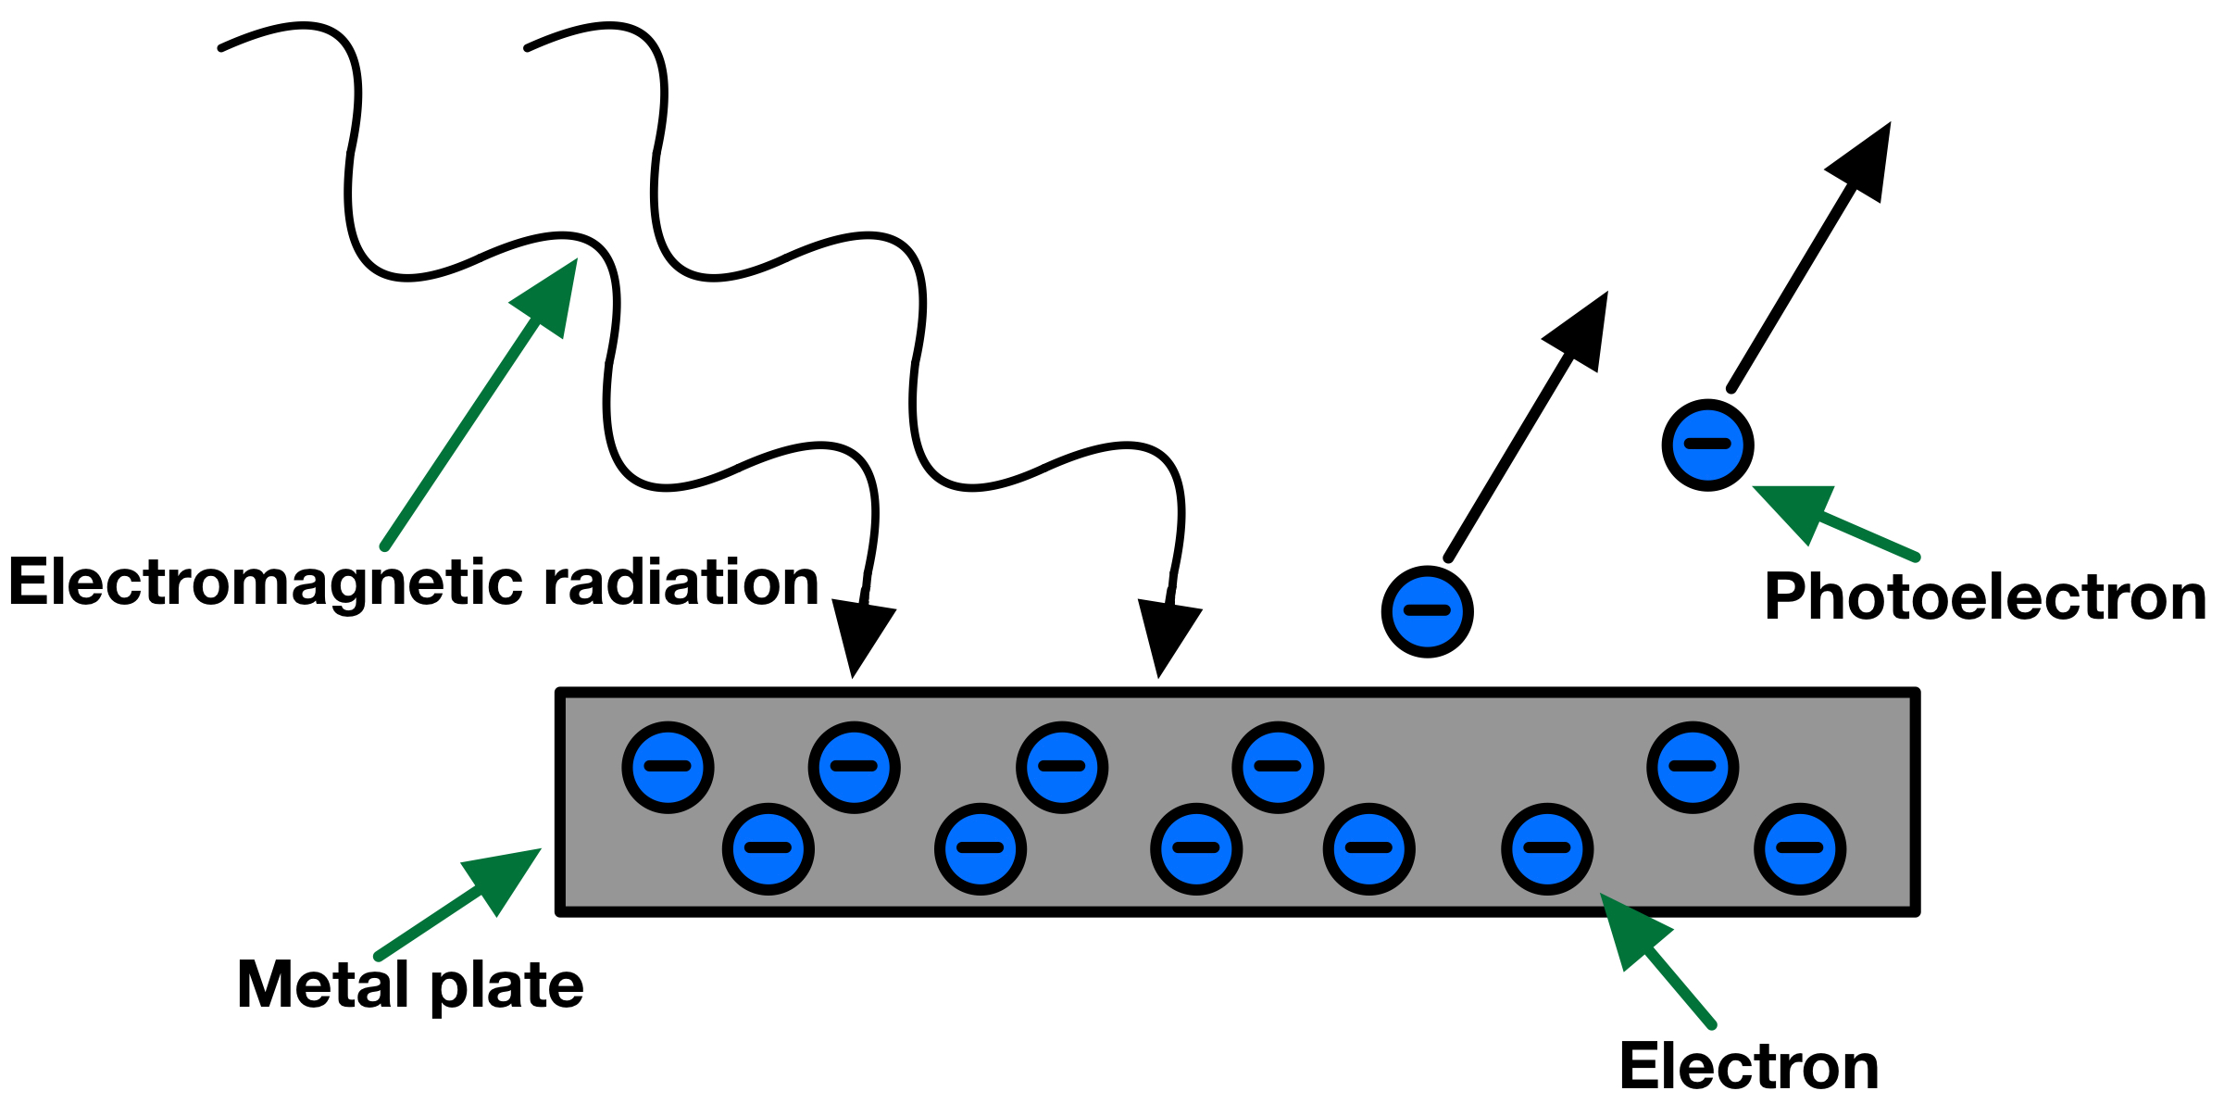
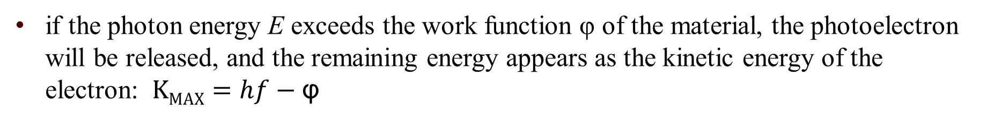
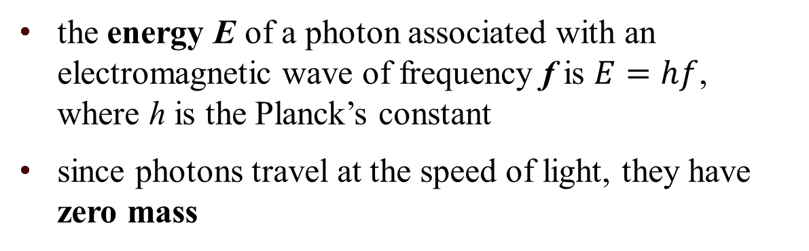
Photoelectric Effect (2)
Albert Einstein developed in 1905 a successful theory of the photoelectric effect:
the energy of electromagnetic radiation is concentrated in localized bundles, called photons
the energy E of a photon associated with an electromagnetic wave of frequency f is $E=hf$, where h is the Planck’s constant
since photons travel at the speed of light, they have zero mass
if the photon energy E exceeds the work function φ of the material, the photoelectron will be released, and the remaining energy appears as the kinetic energy of the electron: $KMAX=hf−\text{φ}$

Slide 9
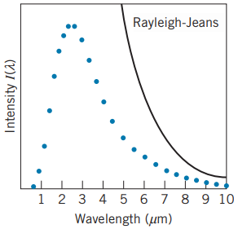
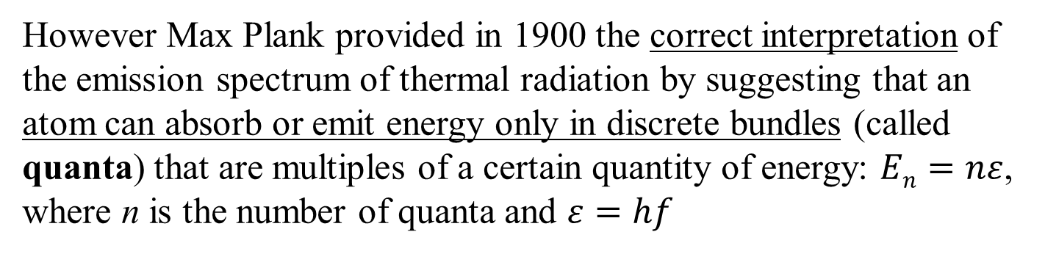
Black Body Radiation
The electromagnetic radiation emitted by objects according to their temperature is called thermal radiation.
An object which absorbs all the incident radiation and does not reflect any of that radiation is called a blackbody.
Classical theories of electromagnetism and thermodynamics predicted that the intensity of the radiation would tend to infinity as its wavelength tends to zero.
However Max Plank provided in 1900 the correct interpretation of the emission spectrum of thermal radiation by suggesting that an atom can absorb or emit energy only in discrete bundles (called quanta) that are multiples of a certain quantity of energy: $En=nε$, where n is the number of quanta and $ε=hf$

Slide 10
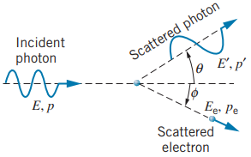
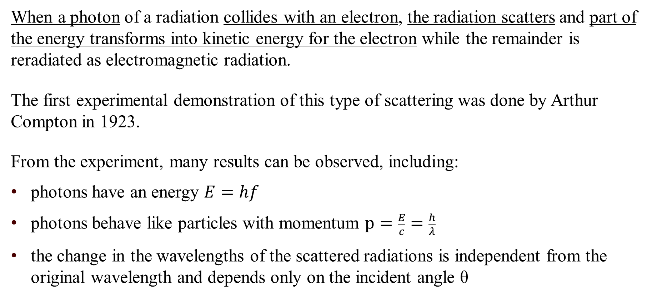
Compton Effect
When a photon of a radiation collides with an electron, the radiation scatters and part of the energy transforms into kinetic energy for the electron while the remainder is reradiated as electromagnetic radiation.
The first experimental demonstration of this type of scattering was done by Arthur Compton in 1923.
From the experiment, many results can be observed, including:
photons have an energy $E=hf$
photons behave like particles with momentum $p=\frac{E}{c}=\frac{h}{λ}$
the change in the wavelengths of the scattered radiations is independent from the original wavelength and depends only on the incident angle θ

Slide 11
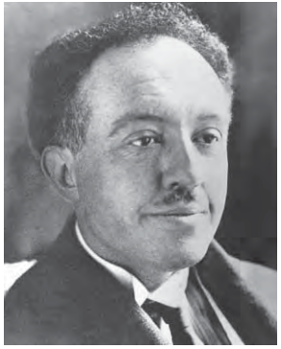
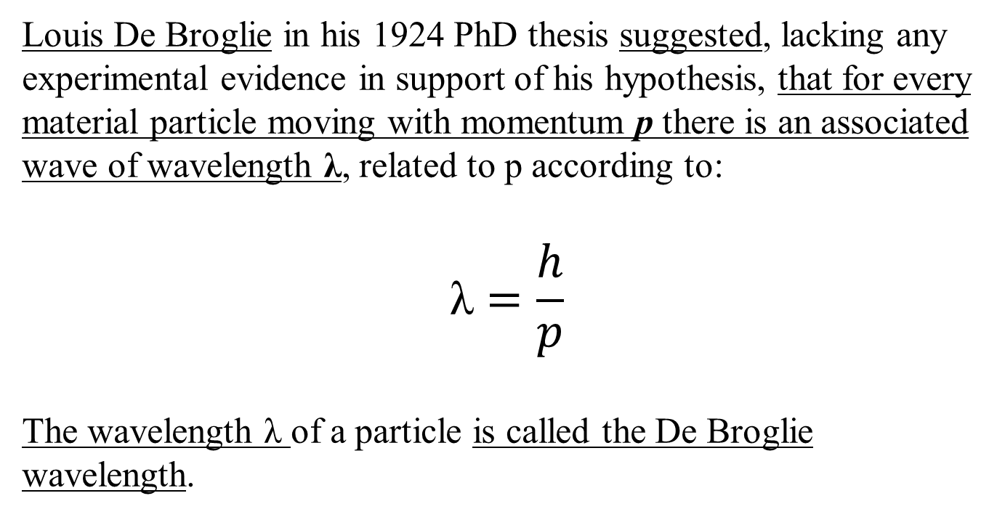
De Broglie’s Hypothesis
Louis De Broglie in his 1924 PhD thesis suggested, lacking any experimental evidence in support of his hypothesis, that for every material particle moving with momentum p there is an associated wave of wavelength λ, related to p according to:
$$\text{λ}=\frac{h}{p}$$
The wavelength λ of a particle is called the De Broglie wavelength.

Slide 12
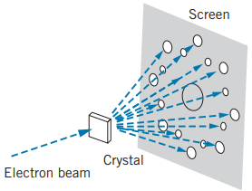
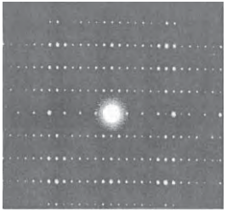
Experimental evidence for De Broglie waves: electron diffraction experiment
The first experiments that verified De Broglie’s hypothesis involved electron diffraction through the atoms of a crystal, performed by G. P. Thomson in 1927.
In an electron diffraction experiment, a beam of electrons is accelerated from rest until it strikes the crystal, and the scattered beam is photographed.
The main observation is that diffraction patterns of electrons and light waves show many similarities, suggesting that the electrons are behaving as waves.

Slide 13
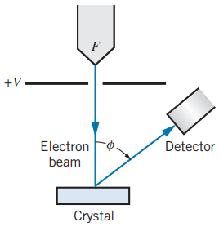
Experimental evidence for De Broglie waves: Davisson and Germer experiment (1)
In 1926, Clinton Davisson and Lester Germer were studying the reflection of electron beams from the surface of nickel crystals.
After passing through a small aperture, the beam strikes a single crystal of nickel.
Electrons are scattered in all directions by the atoms of the nickel crystal, generating a diffraction pattern similar to that of waves.
Some of the scattered electrons strike a detector, which can be moved to any angle ϕ and which measures the intensity of the beam scattered at that angle.

Slide 14
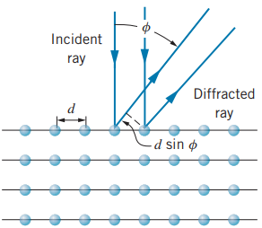
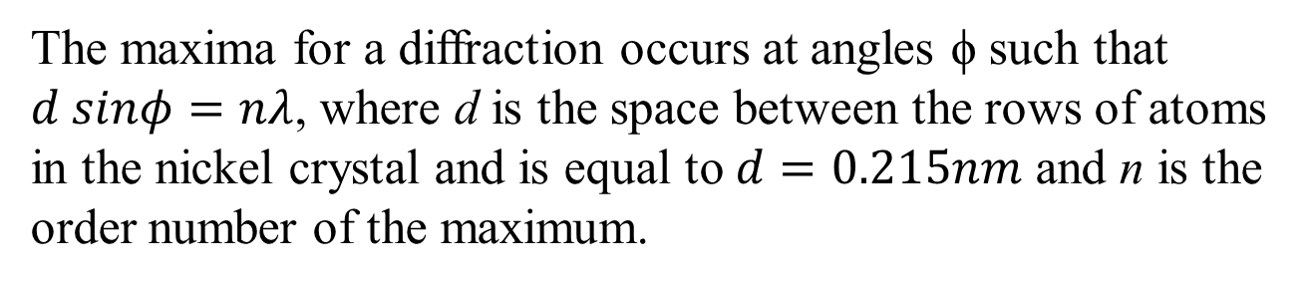
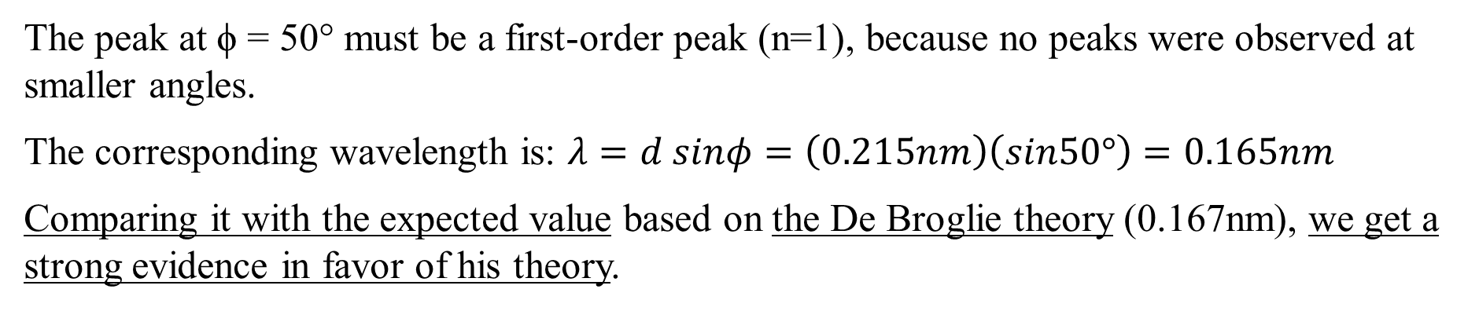
Experimental evidence for De Broglie waves: Davisson and Germer experiment (2)
The maxima for a diffraction occurs at angles ϕ such that $d sinφ=nλ$, where d is the space between the rows of atoms in the nickel crystal and is equal to $d=0.215nm$ and n is the order number of the maximum.
The peak at ϕ = 50° must be a first-order peak (n=1), because no peaks were observed at smaller angles.
The corresponding wavelength is: $λ=d sinφ=\left(0.215nm\right)\left(sin50°\right)=0.165nm$
Comparing it with the expected value based on the De Broglie theory (0.167nm), we get a strong evidence in favor of his theory.

Slide 15
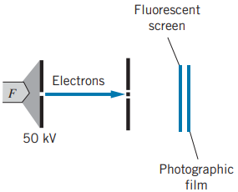
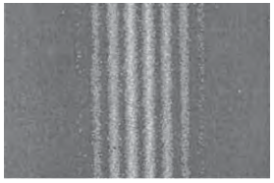
Experimental evidence for De Broglie
waves: double-slit experiment with particles (1)
The first double-slit experiment with particles was done in 1961, where electrons were accelerated through a potential difference and the passed through a double slit.
When they strike a fluorescent screen, the pattern observed is the same of that obtained with light waves.
Electrons are therefore diffracting through the two slits and are interfering with each other.

Slide 16
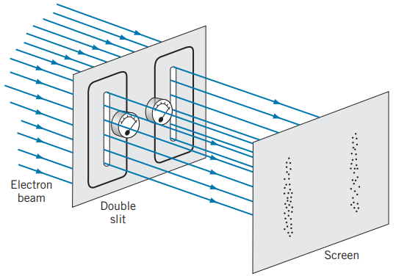
Experimental evidence for De Broglie
waves: double-slit experiment with particles (2)
When performing a double-slit experiment with electrons, it is interesting in trying to determine through which slit the particles pass.
If the particles are fired through the slits at a slow enough rate, such that we could track each particle as it passed through one slit or the other, we will observe a different pattern with respect to when interference occurs.
The pattern observed would be that seen in the image, with dots in front of each slit and without interference pattern.
When performing this type of experiment, we are in fact only investigating the particle aspect and we cannot observe its wave nature.

Slide 17
The principle of complementarity
According to the principle of complementarity, particles can exhibit both particle and wave behaviors, but not both at the same time.
A particle such as an electron can be described as either a point particle or a wave.
It is not possible to observe both aspects simultaneously in the execution of a single experiment or measurement:
when performing a particle-type experiment we only observe a particle-like behavior
when performing a wave-type experiment we can only observe a wave-like behavior
In conclusion, this principle suggest that the subatomic particles’ nature is inherently dual, and the particle and wave behaviors are complementary to each other.

Slide 18
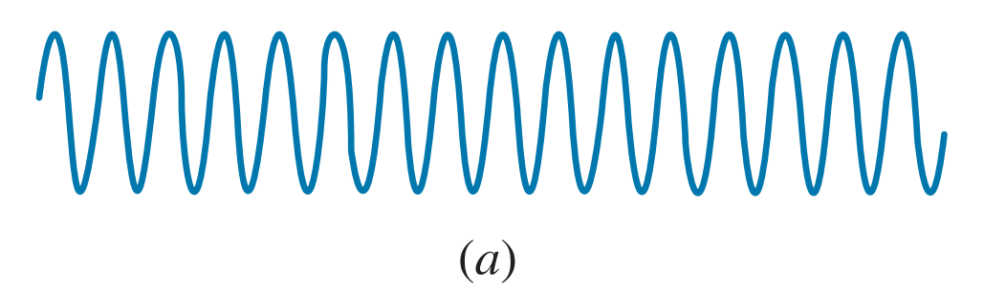

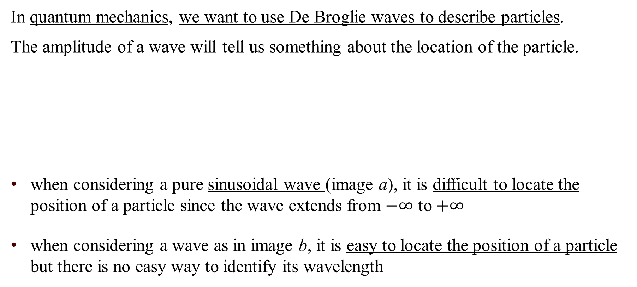
Uncertainty relationships for classical waves (1)
In quantum mechanics, we want to use De Broglie waves to describe particles.
The amplitude of a wave will tell us something about the location of the particle.
when considering a pure sinusoidal wave (image a), it is difficult to locate the position of a particle since the wave extends from $−∞$ to $+∞$
when considering a wave as in image b, it is easy to locate the position of a particle but there is no easy way to identify its wavelength

Slide 19
Uncertainty relationships for classical waves (2)
In the case of the first image, we exactly know the wavelength, but we don’t know the position of the particle. In the case of the second image, we have a good knowledge of the position of the particle, but we have a little knowledge about its wavelength.
Since the wavelength is associated with momentum by the De Broglie relationship, a poor knowledge of the wavelength is associated with a poor knowledge of the particle’s momentum.
Whereas for a classical particle we would like to know both its location and momentum the most precise as possible, for a quantum particle the better we know its wavelength (and consequently its momentum) the less we know about its location.
We can only improve our knowledge of its location at the expense of our knowledge of its momentum and vice versa.

Slide 20
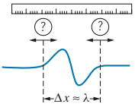
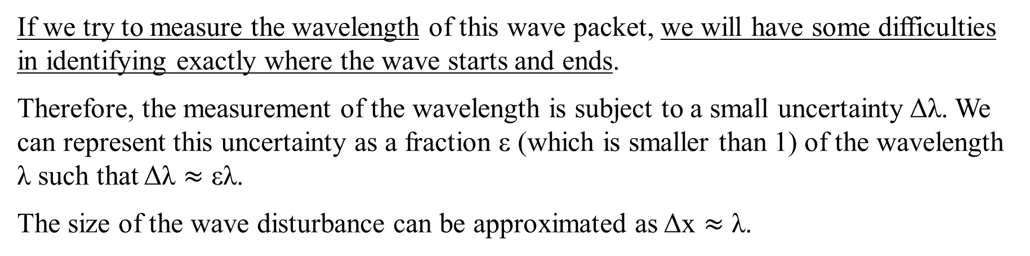
Uncertainty relationships for classical waves (3)
All real waves can be described as wave packets, that are disturbances localized to a finite region of space. A wave packet has a form as the one in the figure where the disturbance is localized in a small region of space with length Δx.
If we try to measure the wavelength of this wave packet, we will have some difficulties in identifying exactly where the wave starts and ends.
Therefore, the measurement of the wavelength is subject to a small uncertainty Δλ. We can represent this uncertainty as a fraction ε (which is smaller than 1) of the wavelength λ such that Δλ $≈$ ελ.
The size of the wave disturbance can be approximated as Δx $≈$ λ.

Slide 21
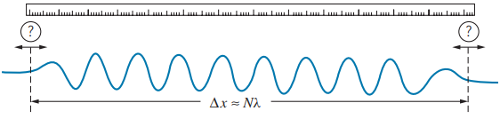
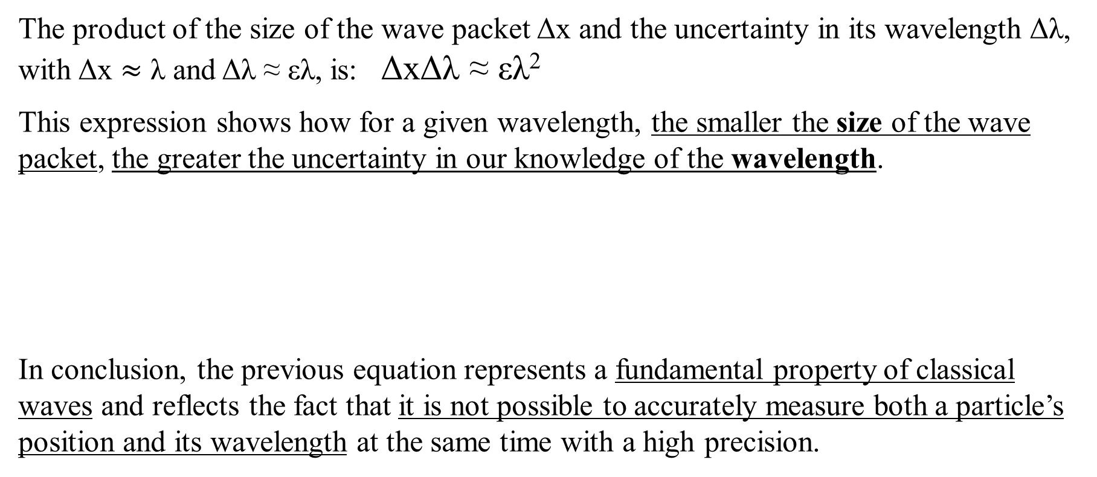
Uncertainty relationships for classical waves (4)
The product of the size of the wave packet Δx and the uncertainty in its wavelength Δλ, with Δx $≈$ λ and Δλ ≈ ελ, is: ΔxΔλ ≈ ελ²
This expression shows how for a given wavelength, the smaller the size of the wave packet, the greater the uncertainty in our knowledge of the wavelength.
In conclusion, the previous equation represents a fundamental property of classical waves and reflects the fact that it is not possible to accurately measure both a particle’s position and its wavelength at the same time with a high precision.
Even in the case of a larger wave packet as in the figure, the product of Δx with Δλ still yields ελ², as in the case of a smaller wave packet.

Slide 22
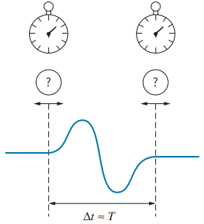
Uncertainty relationships for classical waves (5)
The previous relationship considered the size of a wave packet and the uncertainty in its wavelength.
This relationship is very similar to the previous one in that we first considered a space relationship and now it is a time relationship.
We can additionally rewrite this relationship in terms of the frequency as: ΔfΔt ≈ ε
However, it is possible to define other uncertainty relationships as the frequency-time relationship:
instead of measuring the wavelength of the wave packet, a measurement of the period Δt is performed
with the measurement of the period comes an uncertainty ΔT in measuring it
we obtain the product of Δt and ΔT as: ΔtΔT ≈ εT²

Slide 23
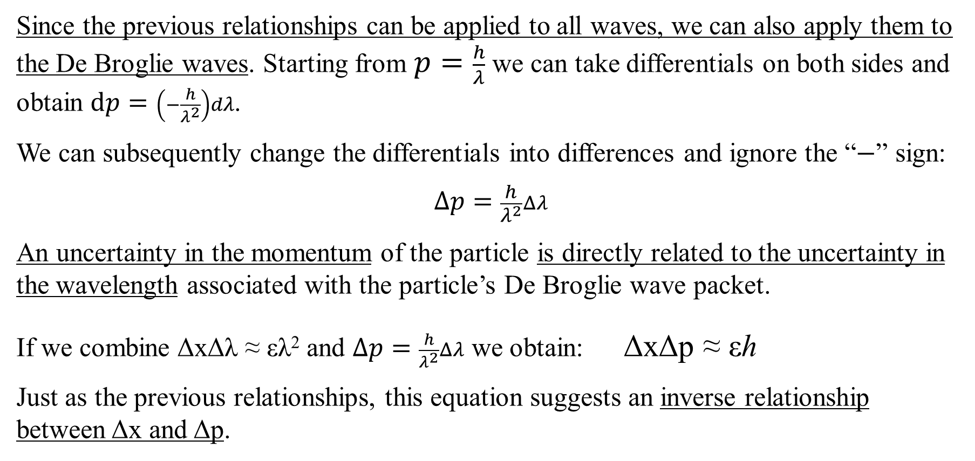
Heisenberg uncertainty relationships (1)
Since the previous relationships can be applied to all waves, we can also apply them to the De Broglie waves. Starting from $p=\frac{h}{λ}$ we can take differentials on both sides and obtain $dp=\left(−\frac{h}{λ^{2}}\right)dλ$.
We can subsequently change the differentials into differences and ignore the “$−$” sign:
$$Δp=\frac{h}{λ^{2}}Δλ$$
An uncertainty in the momentum of the particle is directly related to the uncertainty in the wavelength associated with the particle’s De Broglie wave packet.
If we combine ΔxΔλ ≈ ελ² and $Δp=\frac{h}{λ^{2}}Δλ$ we obtain: ΔxΔp ≈ εh
Just as the previous relationships, this equation suggests an inverse relationship between Δx and Δp.

Slide 24
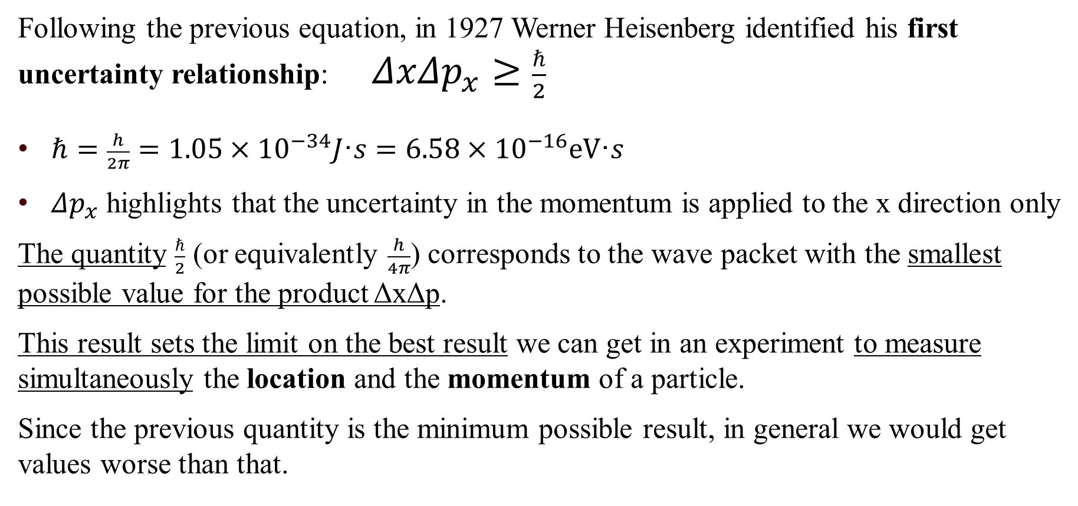
Heisenberg uncertainty relationships (2)
Following the previous equation, in 1927 Werner Heisenberg identified his first uncertainty relationship: $ΔxΔp_{x}≥\frac{ℏ}{2}$
$ℏ=\frac{h}{2π}=1.05×10^{−34}J\text{·}s=6.58×10^{−16}\text{eV}\text{·}s$
$Δp_{x}$ highlights that the uncertainty in the momentum is applied to the x direction only
The quantity $\frac{ℏ}{2}$ (or equivalently $\frac{h}{4π}$) corresponds to the wave packet with the smallest possible value for the product ΔxΔp.
This result sets the limit on the best result we can get in an experiment to measure simultaneously the location and the momentum of a particle.
Since the previous quantity is the minimum possible result, in general we would get values worse than that.

Slide 25
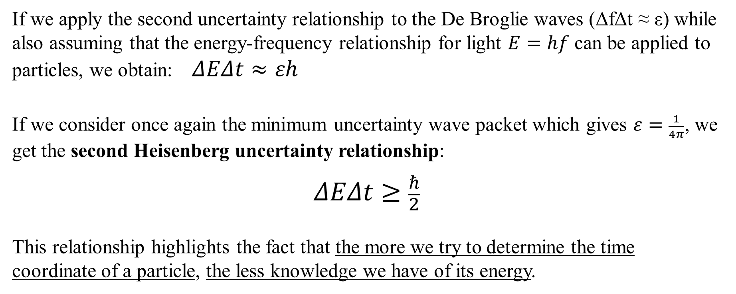
Heisenberg uncertainty relationships (3)
If we apply the second uncertainty relationship to the De Broglie waves (ΔfΔt ≈ ε) while also assuming that the energy-frequency relationship for light $E=hf$ can be applied to particles, we obtain: $ΔEΔt≈εh$
If we consider once again the minimum uncertainty wave packet which gives $ε=\frac{1}{4π}$, we get the second Heisenberg uncertainty relationship:
$$ΔEΔt≥\frac{ℏ}{2}$$
This relationship highlights the fact that the more we try to determine the time coordinate of a particle, the less knowledge we have of its energy.

Slide 26
Heisenberg uncertainty relationships (4)
In conclusion, the Heisenberg uncertainty relationships mathematically represent the Heisenberg uncertainty principle, which states:
it is not possible to make a simultaneous determination of the position and the momentum of a particle with unlimited precision
it is not possible to make a simultaneous determination of the energy and the time coordinate of a particle with unlimited precision
The previous Heisenberg relationships impose a limit on the accuracy with which we can do experiments, a limit that cannot be reduced with technological improvements.
This is the reason why instead of being named “uncertainty” relationships, sometimes they are called “indeterminacy” relationships.

Slide 27
Thank you for the attention

